Slide 1

Sentiment Prediction of Drug Reviews using Datamining
Gargeyi BaIPA
Naveen Donthineni

Slide 2
Abstract
The experience of the end user, which in the context of this project is a patient can derive some critical information that might be useful for improving the condition of a patient, can help other patients with similar condition and also help improve the sentiment of certain drug brands. Some studies were performed on how social media influenced the patient’s usage of drugs. Drug review data which captured the reviews of the patients from drugs.com was analyzed in this work. Insights into the usefulness of the drugs and the health conditions described were unearthed. Machine learning algorithms were used to predict the sentiment of the review. The approach to perform sentiment analysis and the techniques that were found to be helpful for cleaning the reviews were explored. A comparison of multiple machine learning models was performed to determine which algorithm works best for the chosen dataset.

Slide 3
Literature Review
Analyze patient satisfaction [1]
Cross domain evaluations of drugs reviews and evaluation of the polarity of the reviews [2]
Analysis on side affects and effectiveness of the reviews on specific drugs [3]
Prediction of sentiment based on the condition [5].
Kaggle competition in 2018, worked on modeling the sentiment of reviews using several machine learning techniques, prediction of the rating based on review, prediction on the condition of the patient based on the review

Slide 4
Data Review
Drugs review data set from UCI Machine learning repository was used
There are 161297 reviews and 6 attributes
Data was obtained by crawling online pharmaceutical websites stated drugs.com [3]

Slide 5
Data cleaning
Removed the missing values which corresponded to 0.5 %
Lower case letters for all the attribute names
Duplicate values were verified
Unique values for drugs were also investigated

Slide 6

Exploratory DATA Analysis

Slide 7
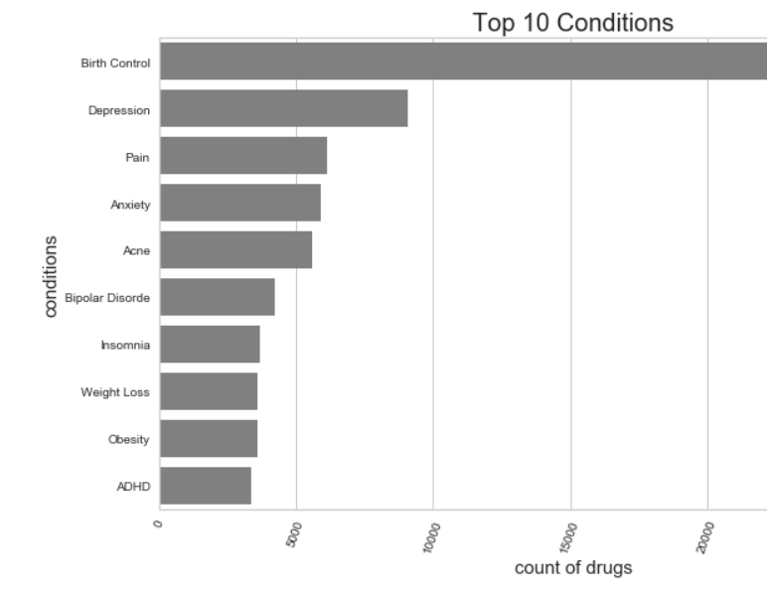
WHAT are the top 10 conditions?
It can see that Birth control,
Depression and Pain are the top 10 conditions

Slide 8
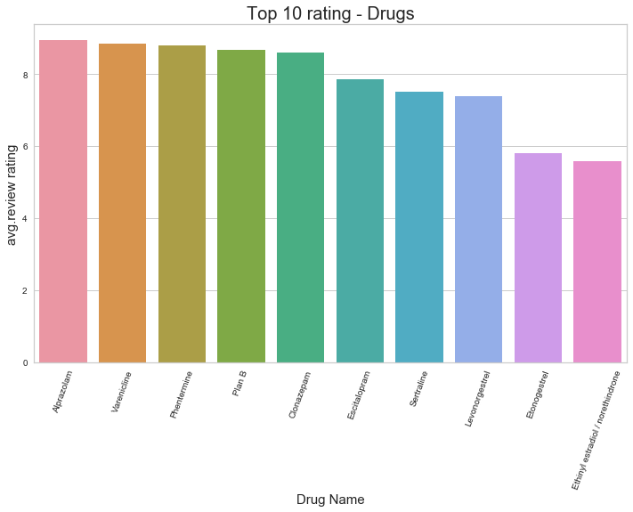
What are the top 10 Drugs?
Alprazolam, Varenicline, Phentermine seem to be the top 3 drugs

Slide 9
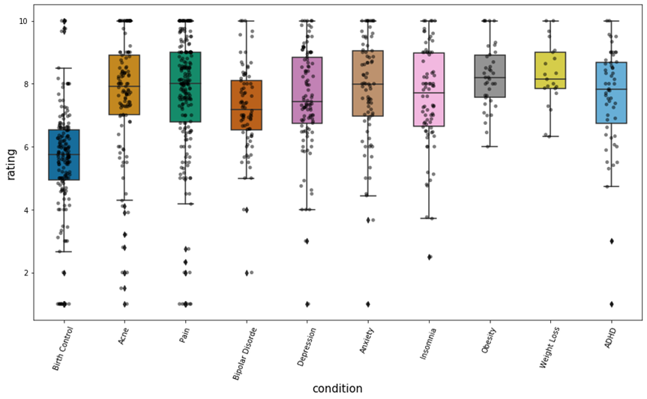
Which health condition Has the greatest number of Drugs?
Analysis shows that birth control, acne, pain has the greatest number of drugs
Low rated drugs - Pain, anxiety, birth control
High rated drugs - weight loss
Condition vs Rating

Slide 10
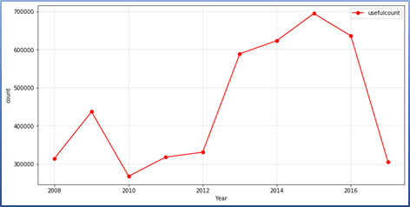
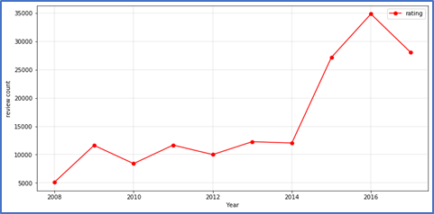
Analysis of review over the time
Useful Count vs Year
Review count vs Year

Slide 11
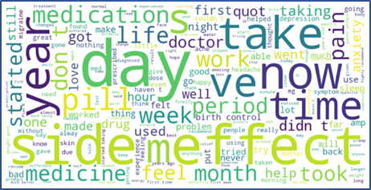
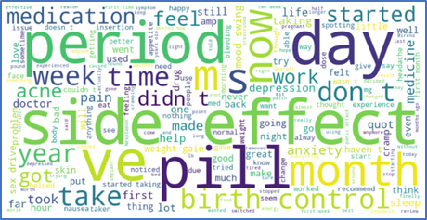
Word cloud on the attribute ‘REVIEW’
Reviews corresponding to top 10 health conditions
Reviews corresponding to top 10 drugs

Slide 12
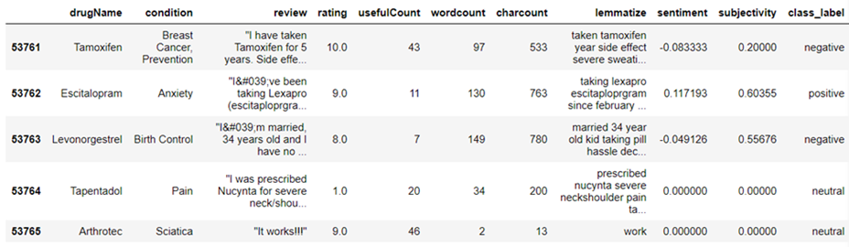
Sentiment Analysis
NLTK package in python used to clean the attribute ‘review’
Removed stop words, punctuations and mistyped values are eliminated
Lemmatization performed with Textblob
Sentiment for each review determined.

Slide 13
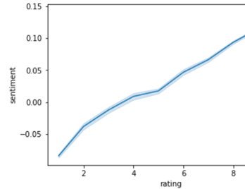
Rating VS Sentiment plot
The sentiment calculated is plotted against rating
Higher sentiment is showing higher rating

Slide 14
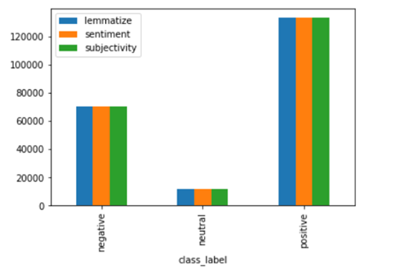
Distribution of sentiments
There were 85951 important features .
The positive sentiment counted to 62%, negative accounted to 33% and neutral sentiment accounted to 5 %

Slide 15
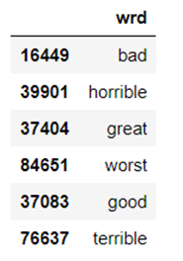
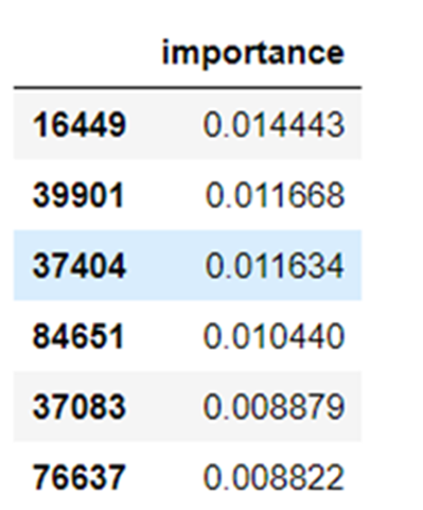
Feature IMportance
There were 8985951 important features
‘featureImportances’ function used for obtaining the importance
The features ‘bad’, ’horrible’, ‘great’ had most importance

Slide 16

DATAMINING Algorithms

Slide 17
Algorithms used
Logistic Regression - multinomial , class weight- balanced
Naïve Bayes – Multinomial for text classification
Decision Tree
Random Forest – The number of trees in the forest is set to 100
Support Vector Machine – linear kernel to prevent overfitting

Slide 18
Accuracy Summary
Model | Accuracy
Logistic Regression | 91.8%
Naïve Bayes | 67.23%
Decision Tree | 90.2%
Random Forest | 89.5%
Support Vector Machine | 95%

Slide 19
ROC CURVE SUMMARY
AUC was least for Naïve bayes classifier
Decision tree has lower accuracy but higher AUC
Neutral class label showed good AUC despite very less data
SVM provided the best AUC values

Slide 20
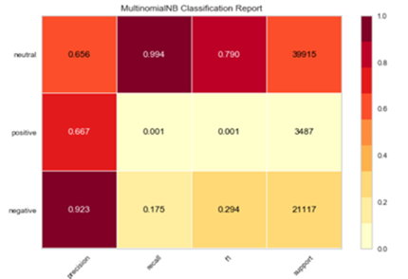
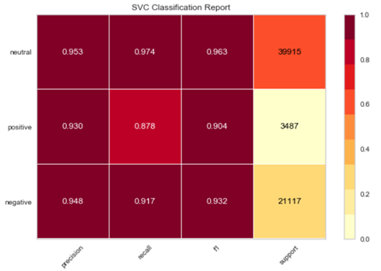
Classification Report Summary
Comparison of the Precision and recall was made between all models ,SVM and Naive Bayes shown here
SVM is a best performer for this dataset for predicting the sentiment

Slide 21
Conclusion
Most negative reviews had high useful count
Pain birth control are among the top conditions with high number of drugs
Data cleaning methods for sentiment analysis explored, and sentiment was derived
Machine learning algorithms were used learn the sentiment in the reviews and predictions were summarized
SVM model suggested with highest accuracy for this data set

Slide 22
References
[1] https://www.sciencedirect.com/science/article/pii/S1665642317300561
[2] https://www.ncbi.nlm.nih.gov/pmc/articles/PMC7233089/pdf/3269957.pdf
[3] https://dl.acm.org/doi/10.1145/3194658.3194677
[4] Yellowbrick Documentation (readthedocs.org)
[5] Sentiment Analysis in Drug Reviews using Supervised Machine Learning Algorithms (arxiv.org)

Slide 23
Thank you !

